Slide 1
Atmospheric Scattering in Vulkan
CSCI 580
Michael Wang, Glenn Jiang, Yifei Miao, Shipeng Liu

Slide 2
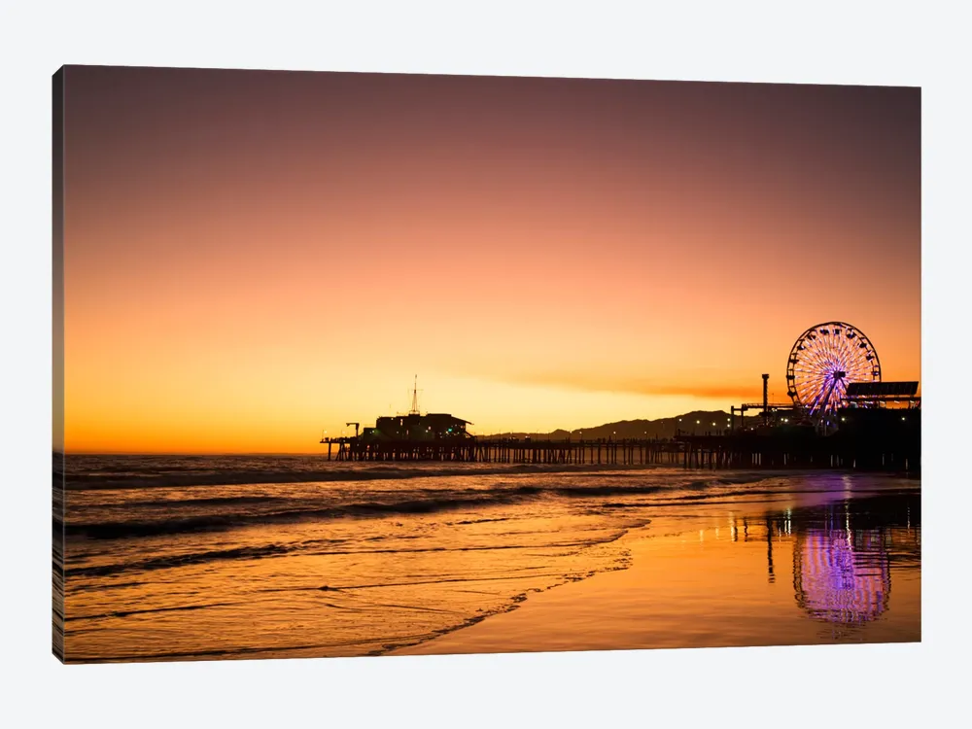
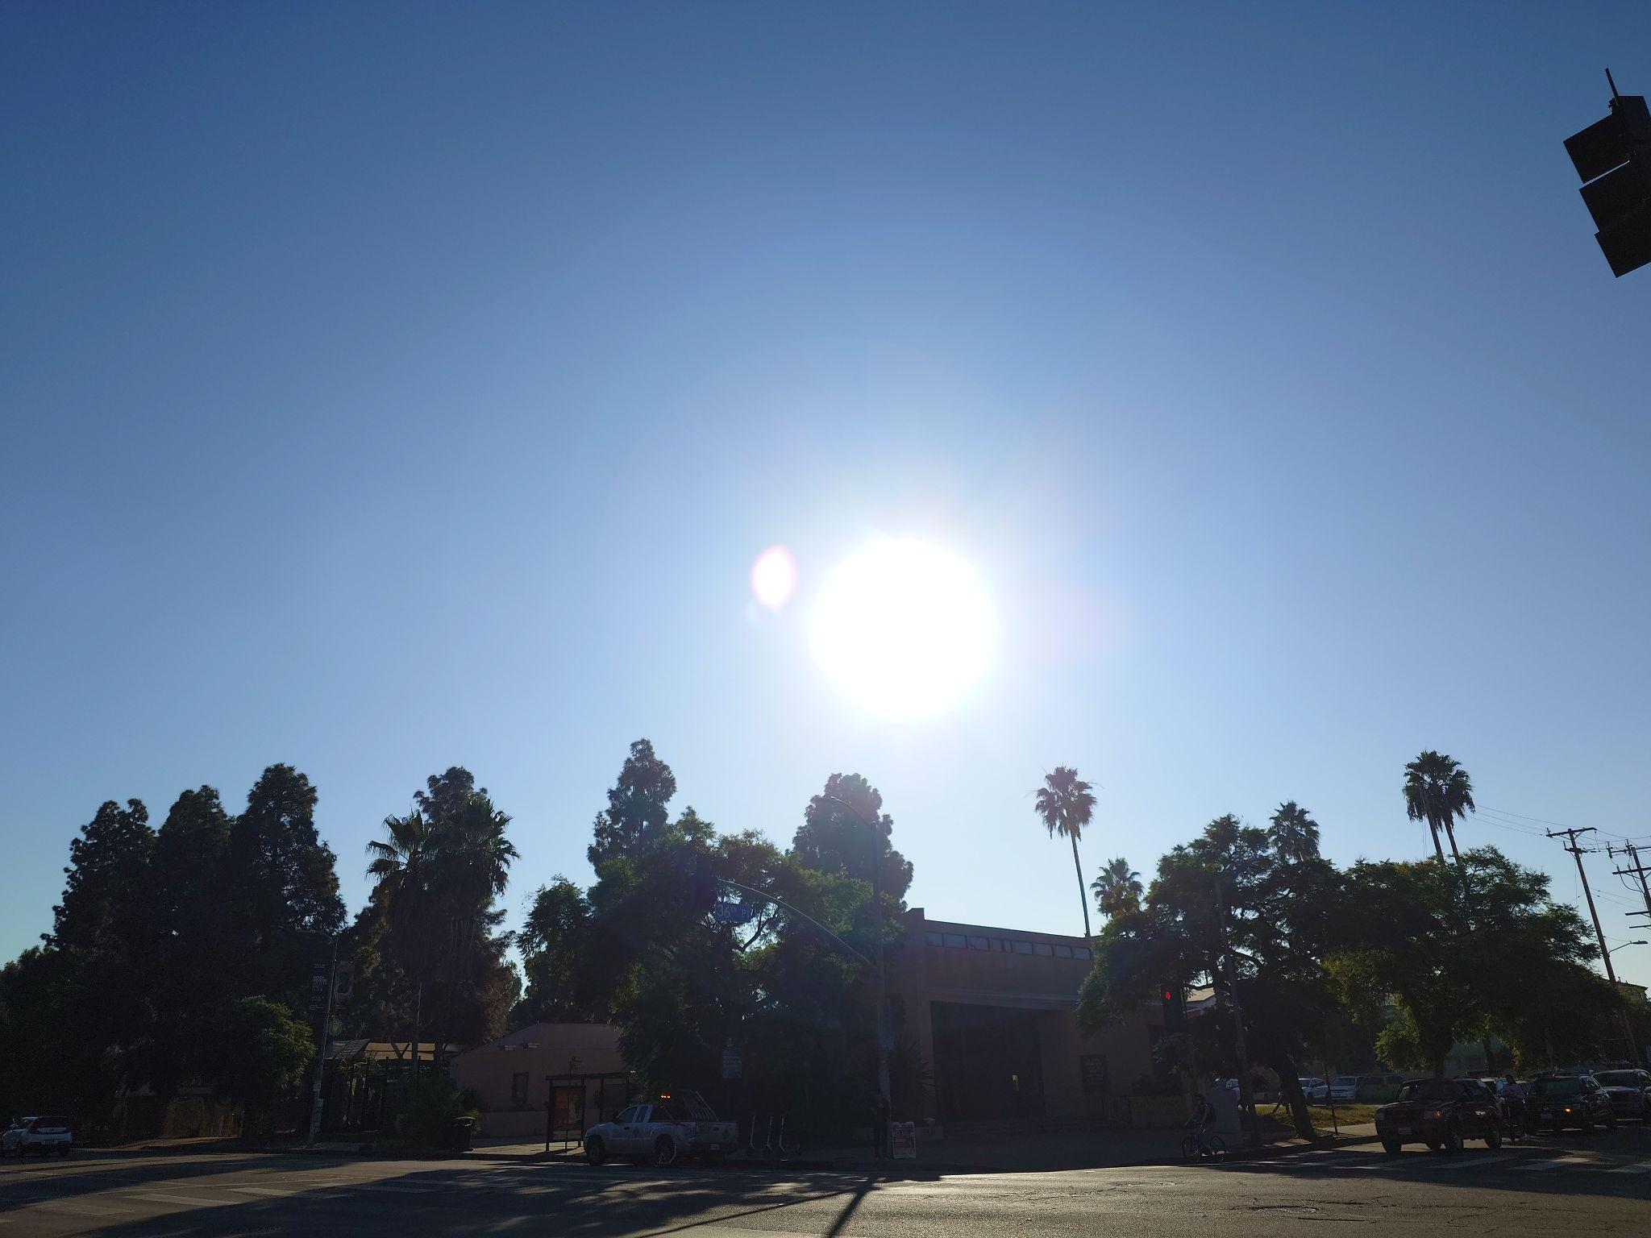
1
Introduction
When it is dawn or dusk, the sun and sky appears to be orange.
When you look at the sky, the sun appears to be white, while the other parts appears to be blue.

Slide 3
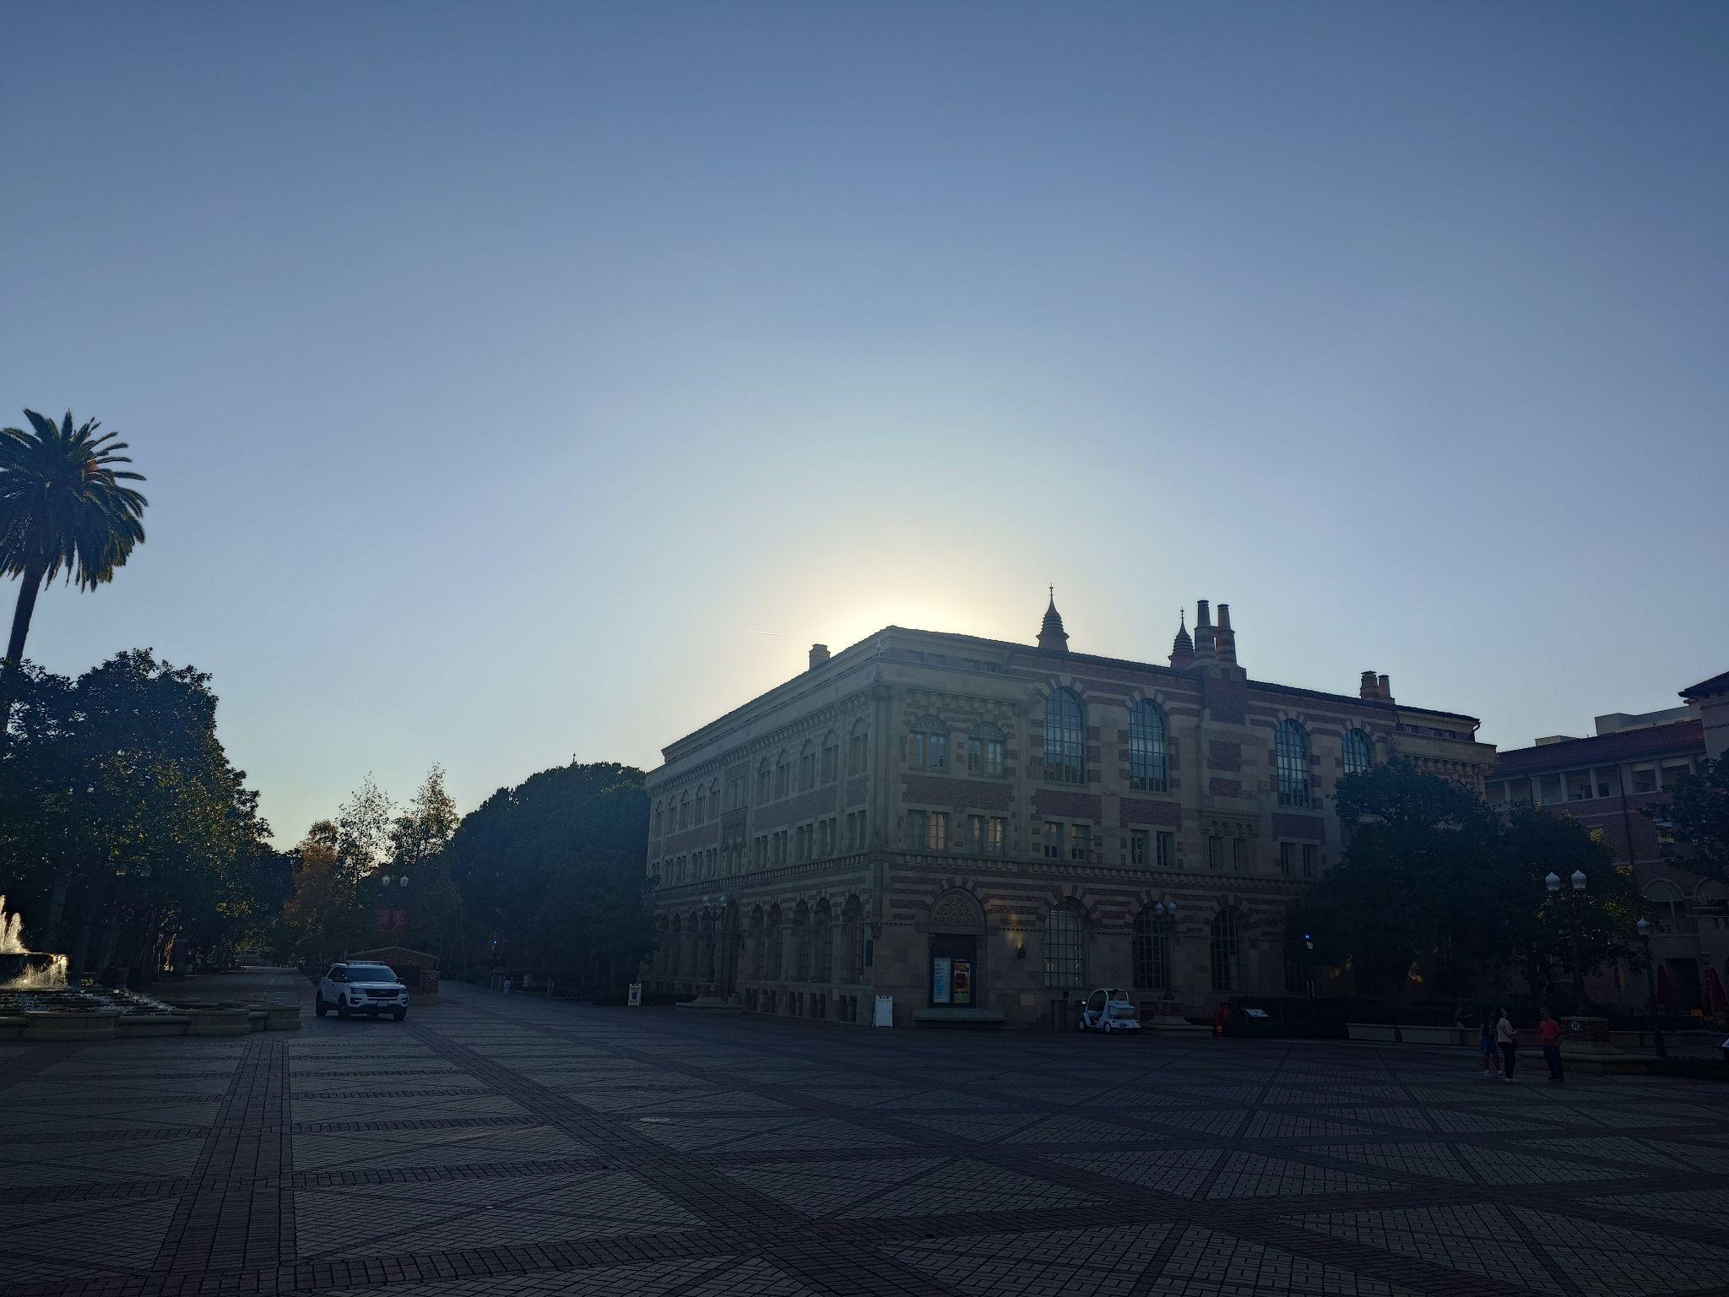
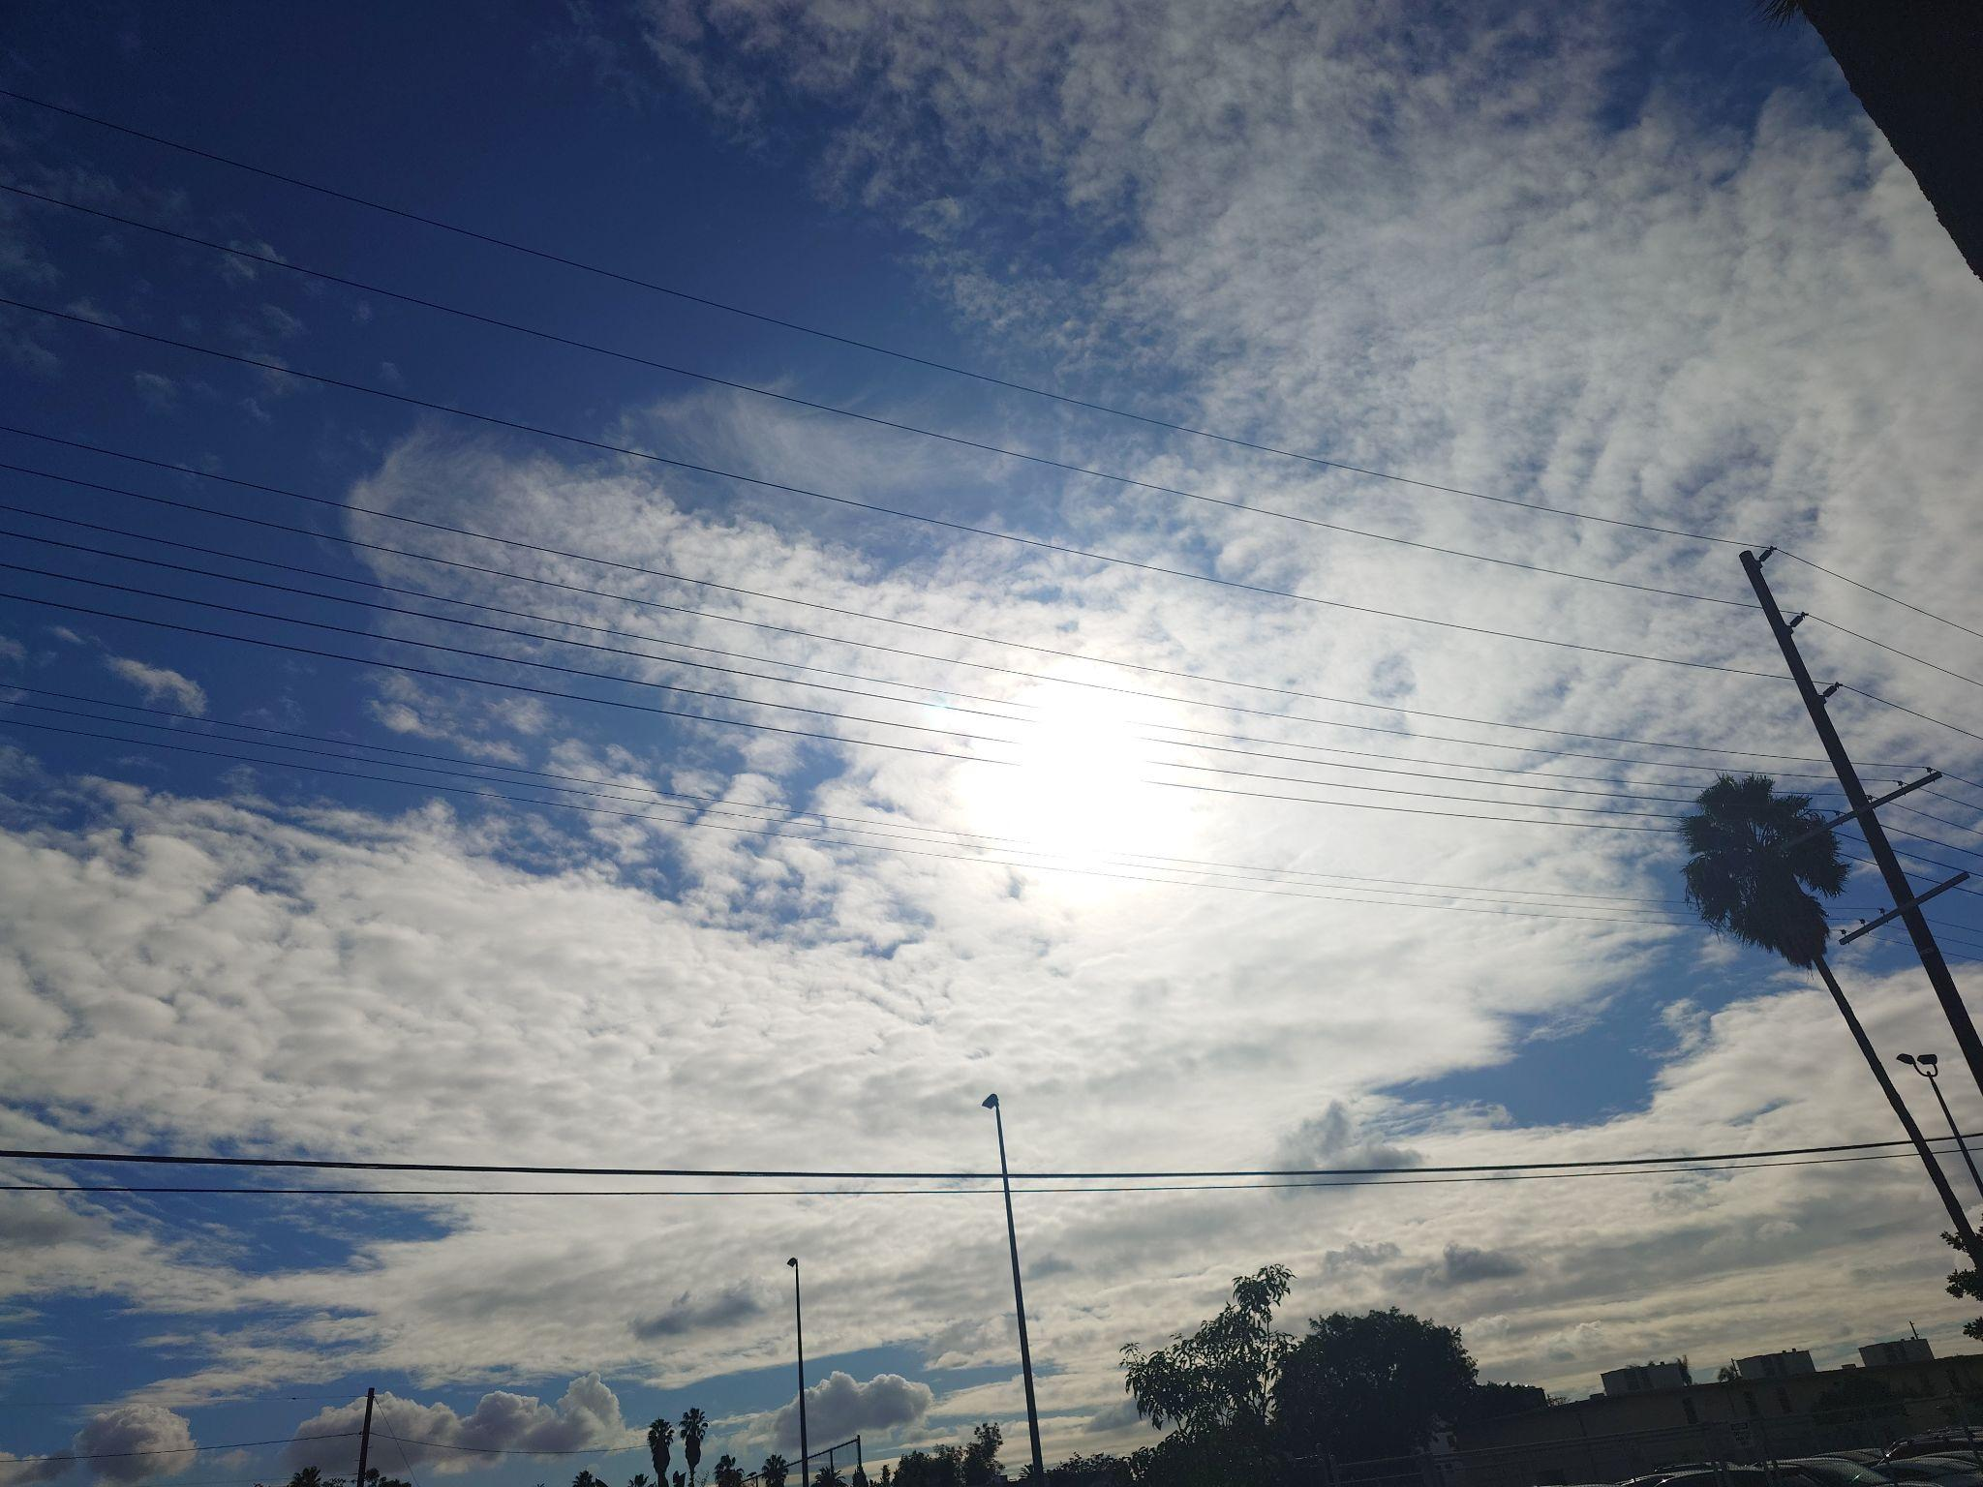
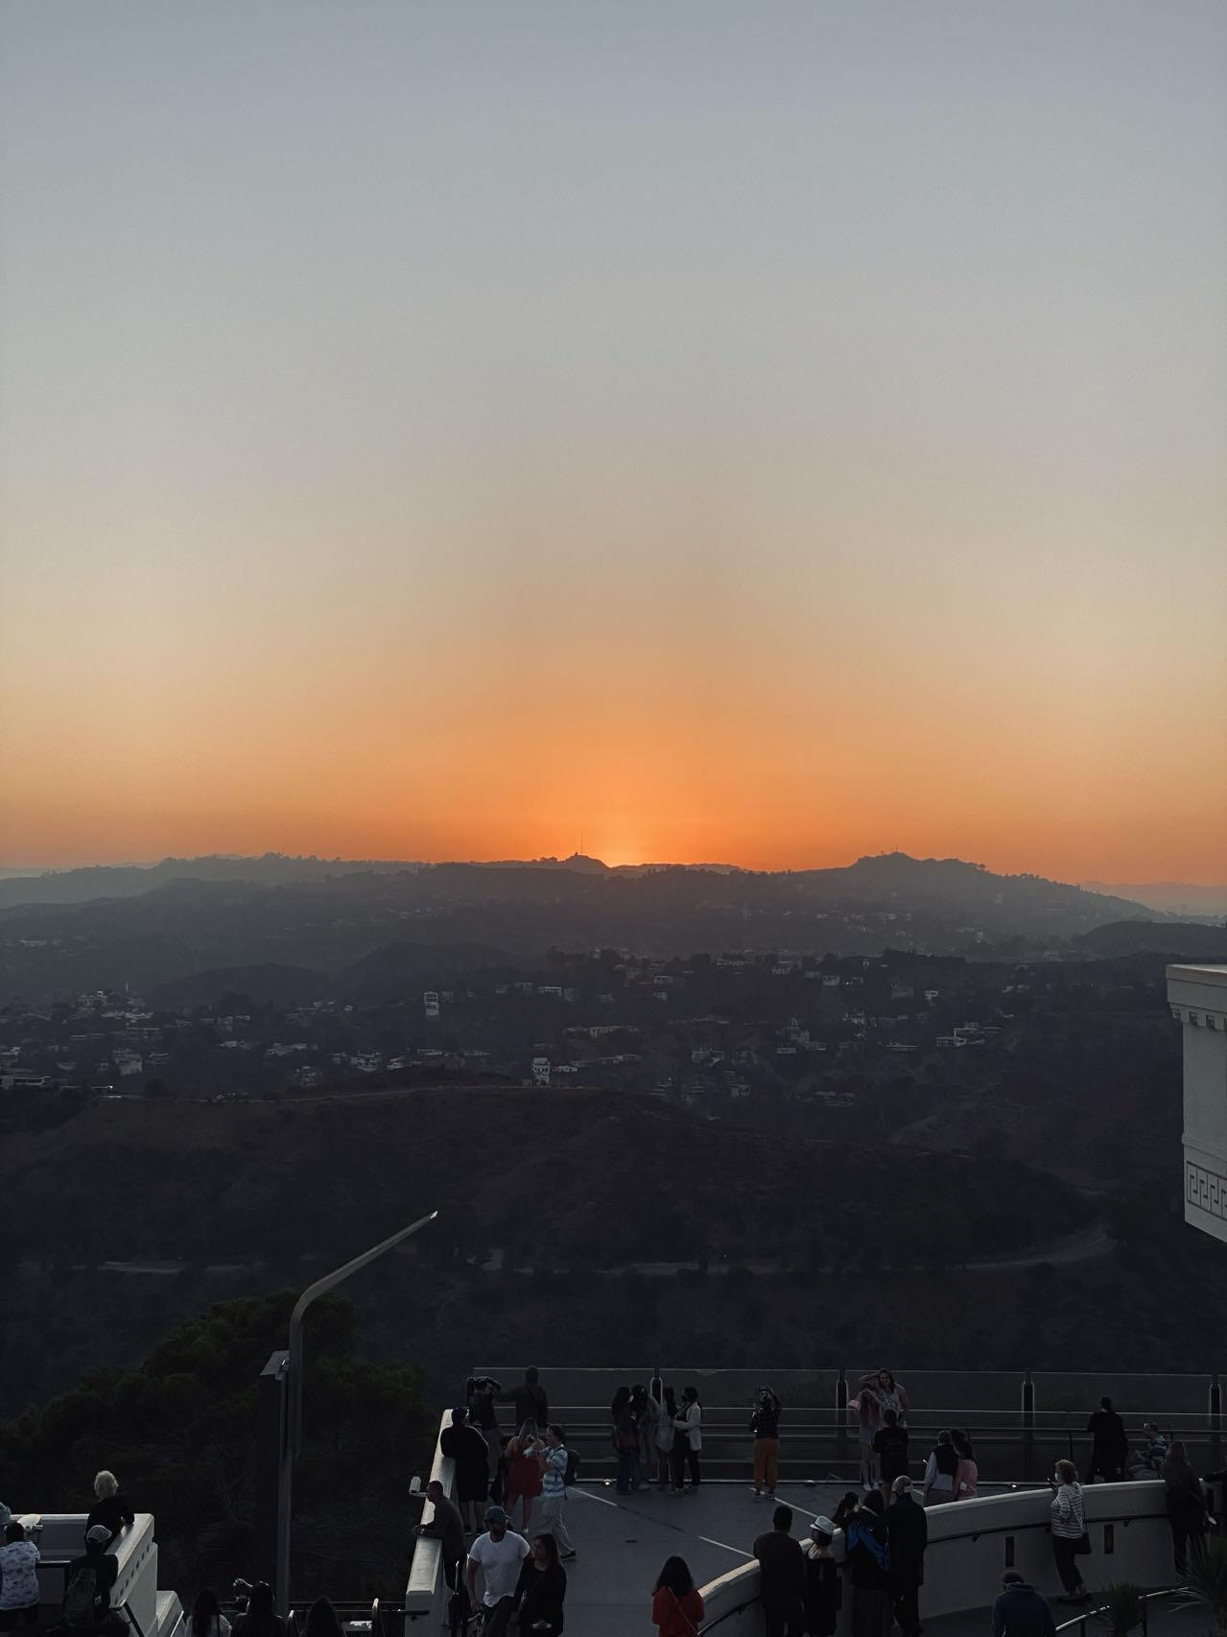
What is an atmosphere?
Atmosphere is a layer of gases surrounding a planet, moon, or other celestial body, held in place by gravity. The atmosphere has a significant impact on how light behaves and is perceived on Earth. Several atmospheric phenomena alter the direction, intensity, and color of light.
Griffith Observatory

Slide 4
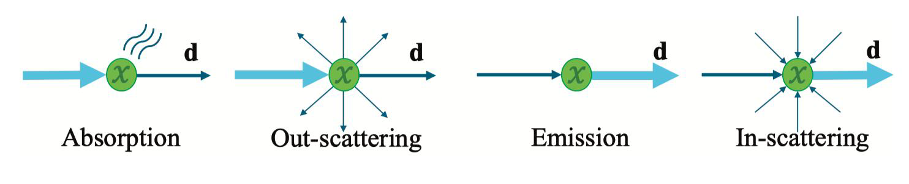
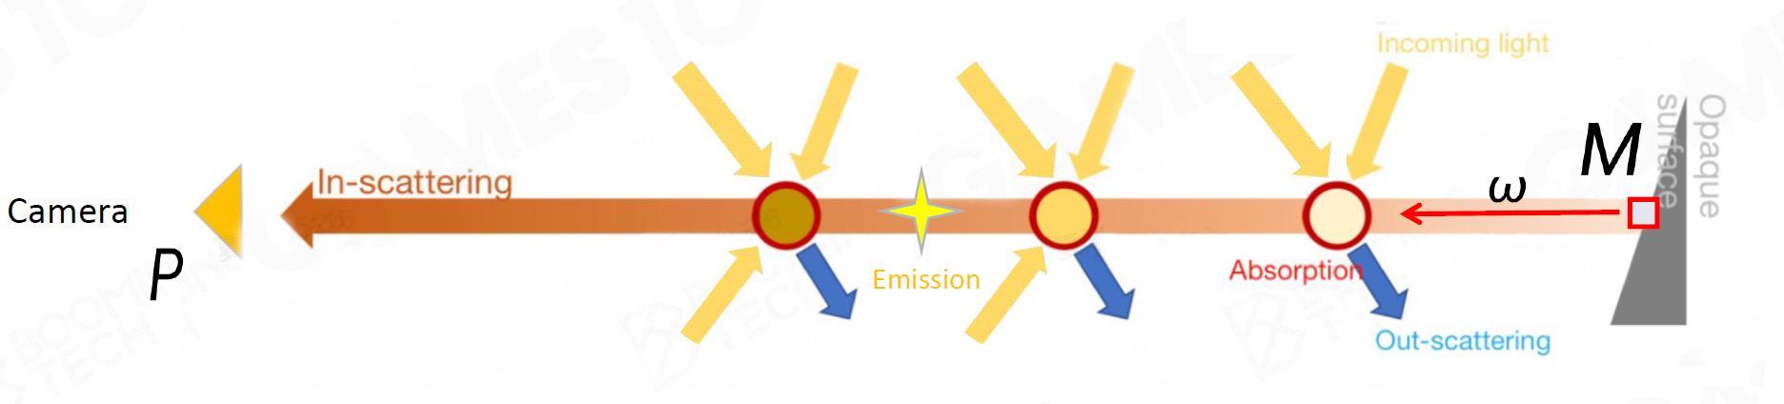

Slide 5
02
How does Scattering affect atmosphere color

Slide 6
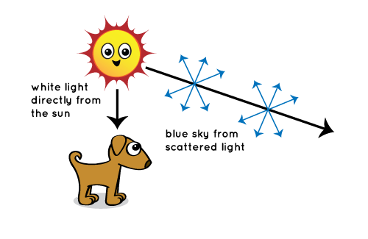
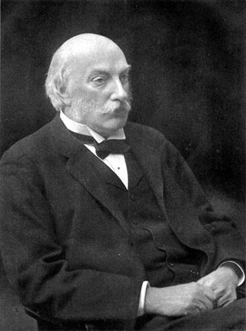
Rayleigh Scattering
When light comes from the sun, it interacts with small particles or molecules in the atmosphere, which are much smaller than the wavelength of light, short wavelengths (blue and violet light) scatters more efficiently than long wavelengths (red light). This is why the sky appears blue on a clear day. This is called Rayleigh Scattering.
John William Strutt
3rd Baron Rayleigh

Slide 7
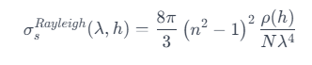
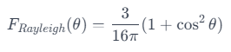
Rayleigh Scattering
We can use the Rayleigh Theory to describe the scattering.
In the Rayleigh scattering coefficient equation:
In the Rayleigh phase equation:
λ: Wavelength of light.(constant)
- h: Height in the atmosphere.
- n: Refractive index of the atmosphere.(constant)
- ρ(h): the density function of particles.
- N: Number of molecules per unit volume at sea level. (constant)
- θ: Angle between your view and the sun
In the coefficient equation, the value is inversely proportional to the wavelength, that is why shorter wavelength lights, like blue light, is the main color in the atmosphere.

Slide 8
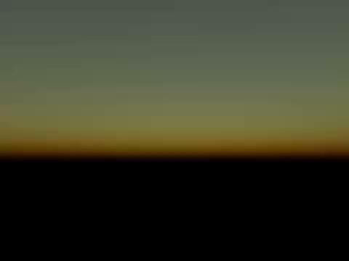
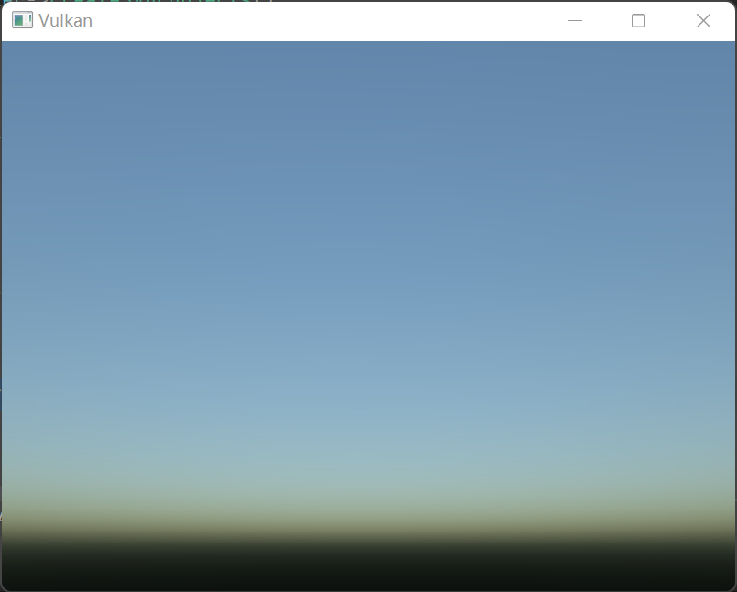

Slide 9
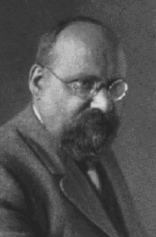
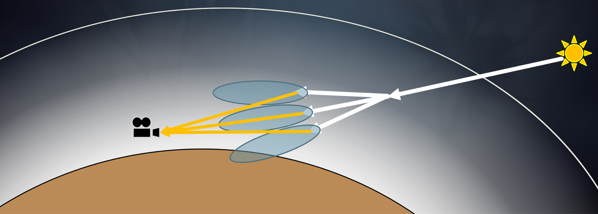
Mie Scattering
Mie Scattering happens when light interacts with larger atmospheric particles like dust, pollen, or water droplets. It scatters all wavelengths almost equally, leading to the white appearance of clouds and sometimes contributing to the whitish color of the sky in polluted or dusty conditions.
Gustav Mie

Slide 10
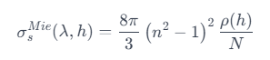
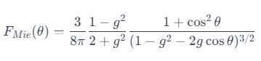
Mie Scattering
Mie scattering occurs when particle sizes are similar or larger to light wavelengths
Mie scattering coefficient equation:
Mie scattering phase function:
- n: Refractive index of the atmosphere.(constant)
- h: Height in the atmosphere.
- ρ(h): the density function of particles.
- g: The asymmetry parameter, which ranges from -1 to 1. A value less than 0 indicates backward scattering, and a value greater than 0 indicates forward scattering. (constant)
- θ: the angle between your view and the sun
- N: Number of molecules per unit volume at sea level. (constant)
As we can see from Mie phase function, the larger your angle is, the less mie scattering effect you will observe. That is why you see a strong white light as your view approaches the sun.

Slide 11
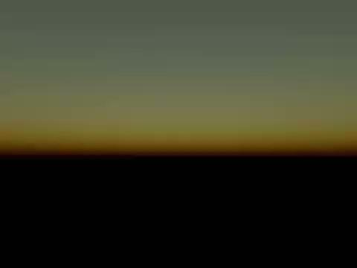


Slide 12
03
Implementation

Slide 13
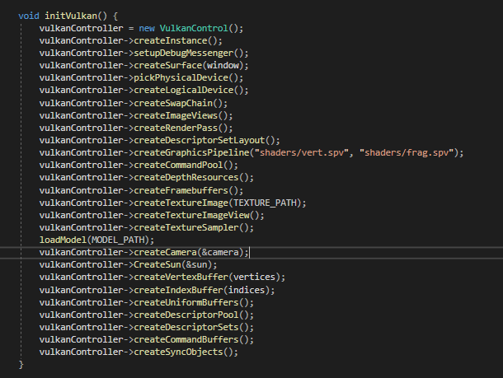
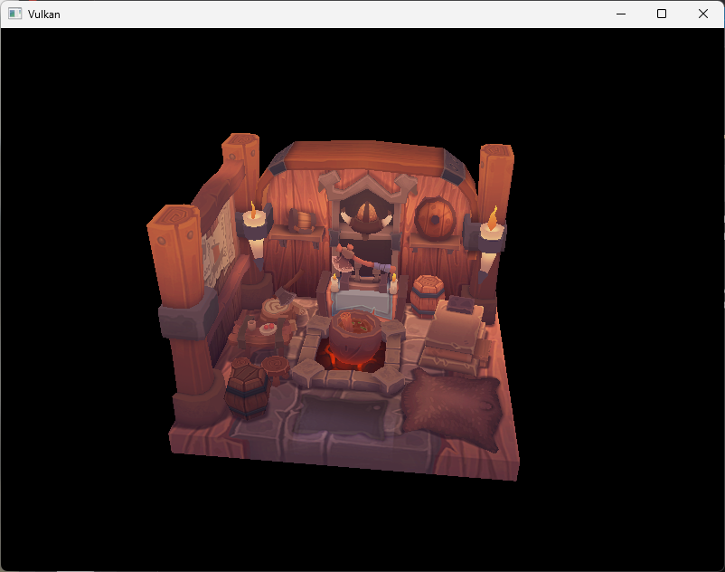
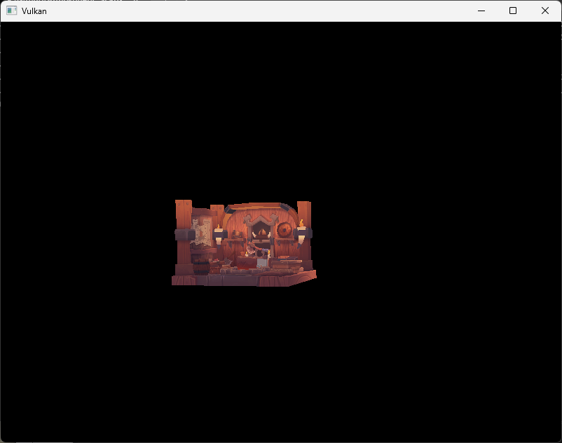
Setup
We first installed VulkanSDK v1.3.268.0 , and added the following libraries to the Visual Studio 2019 v16.11 project: glfw v3.3.8-WIN64 for image output, glm v0.9.9.8 for mathematical calculations, stb for image loading, and tinyobjloader v2.0 for loading .obj files.
https://vulkan-tutorial.com/Introduction
Subsequently, we added functions related to the basic setup of Vulkan, along with camera code and model loading code. In Fig.1, the camera can move freely and has pitch and yaw angles.
https://learnopengl.com/Getting-started/Camera
Fig 1 . Result of project setup and camera setup

Slide 14
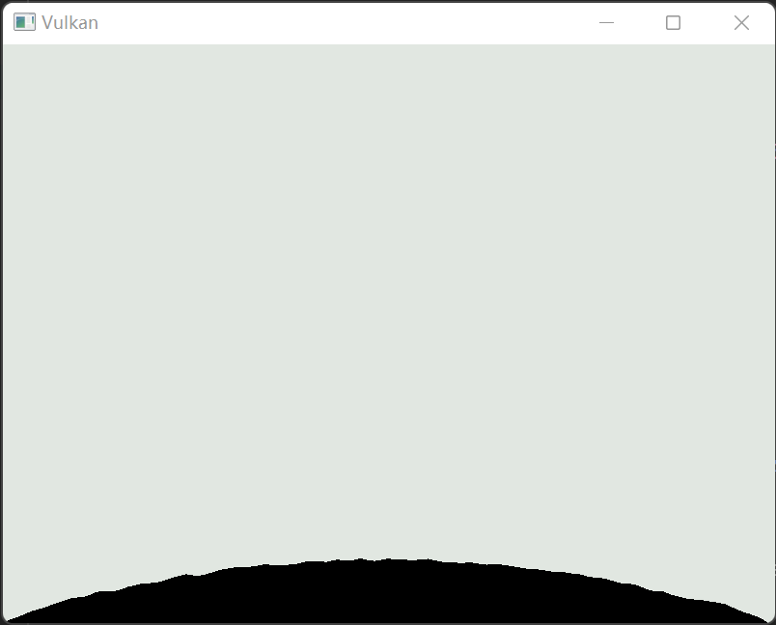
B. SKY
Then we changed the vulkan default object to a spherical object, and placed the camera in the middle to simulate a skybox
Plugging in our Rayleigh and Mie equation and constants suggested by Nishita and Sébastien Hillaire’s paper, it finally showed a horizon(without sun)

Slide 15
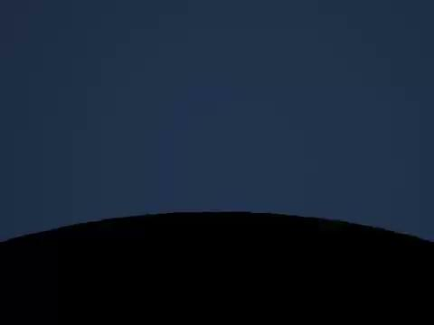
Simply plug in all equation

Slide 16
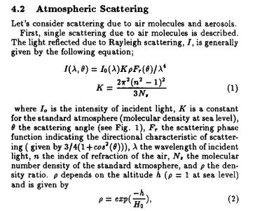
Nishita 1993, Display of The Earth Taking into Account Atmospheric Scattering -
http://nishitalab.org/user/nis/cdrom/sig93_nis.pdf
The density of

Slide 17
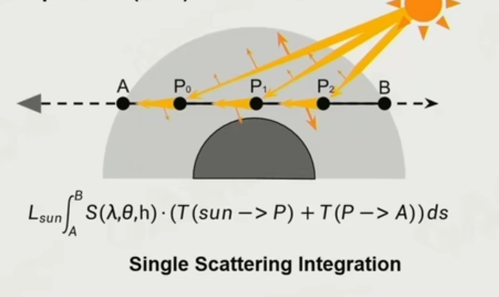
Ray Marching

Slide 18
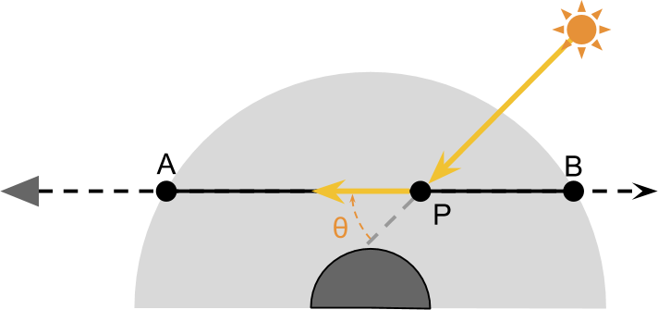
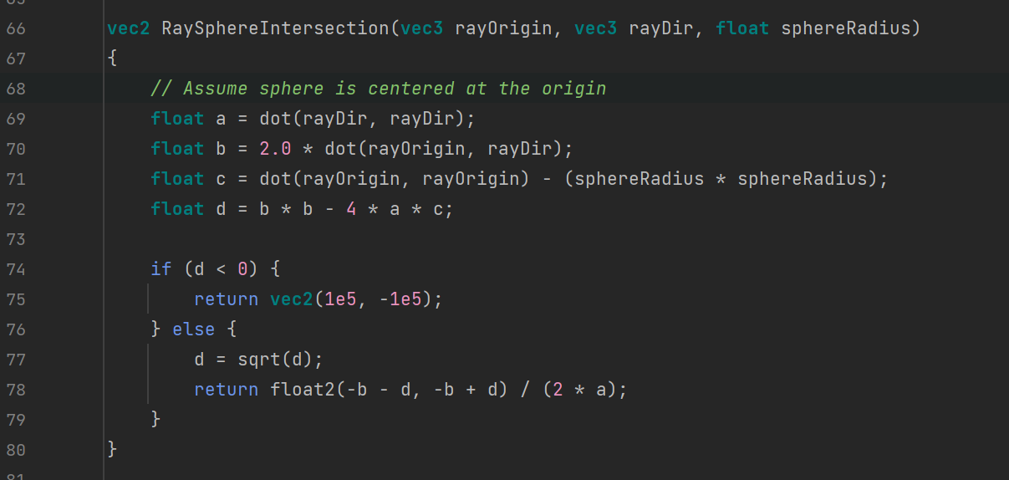
Single Scattering & Ray Sphere Intersection

Slide 19
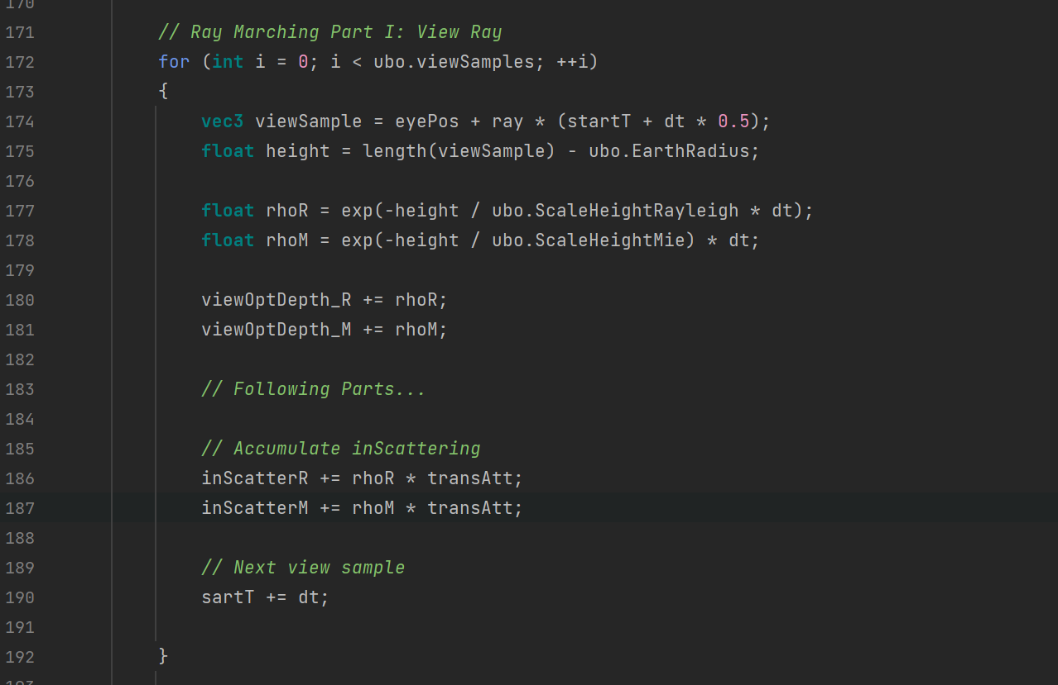
Ray Marching Part I

Slide 20
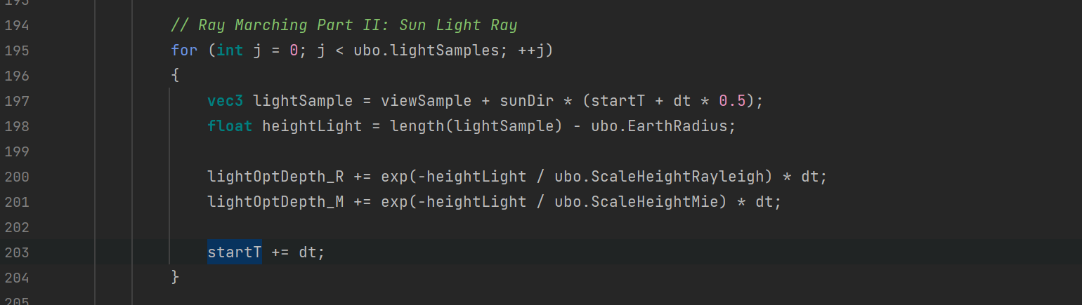
Ray Marching Part II

Slide 21
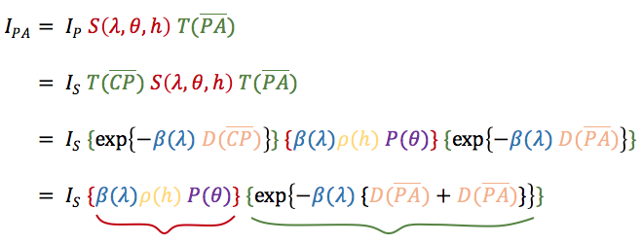
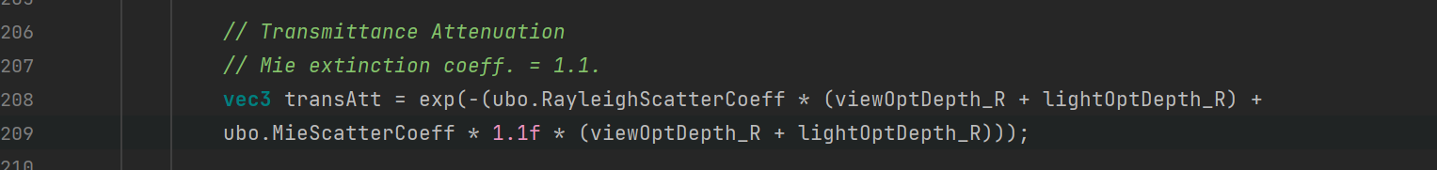
Transmittance Attenuation

Slide 22
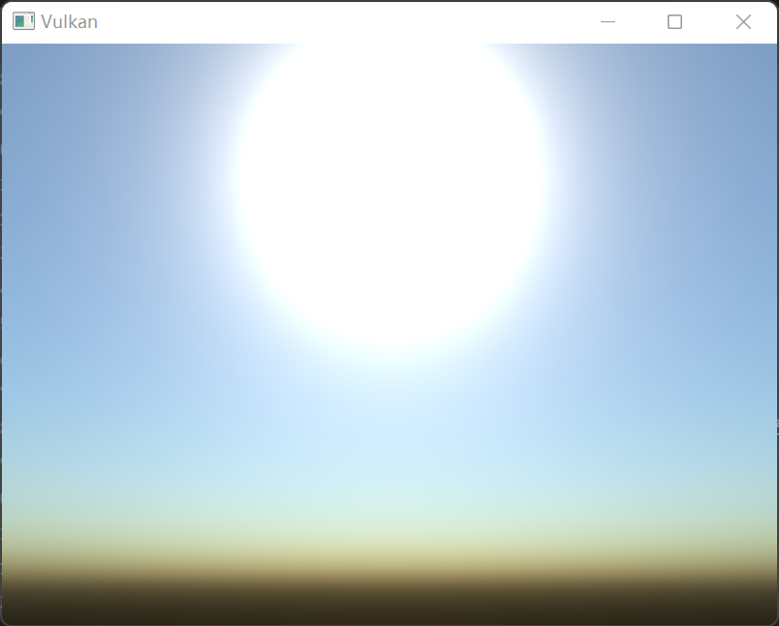
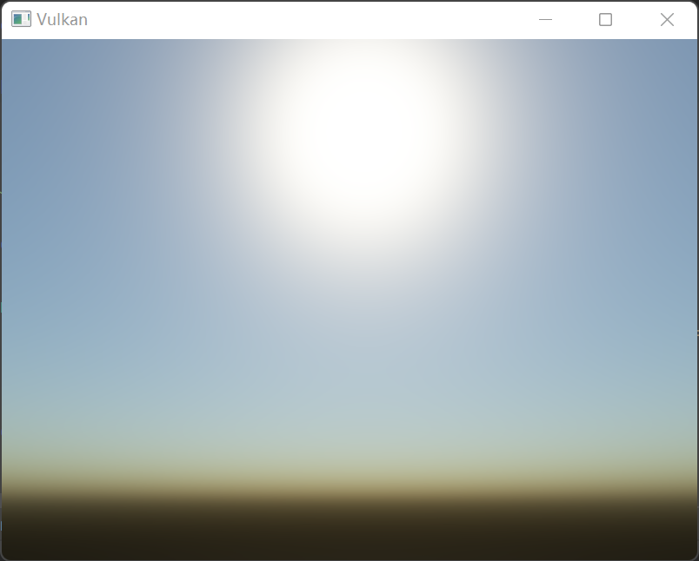
Postprocess: ToneMapping(Addon)

Slide 23
Future Work
New vulkan learners working on Atmospheric scattering is a big workload.
Implement multiple objects rendered in a scene, including a terrain, to display a shadow and ariel effect in the atmosphere.
Count the ozone layer into the atmosphere.
Implement multi-scattering effect.
Implement a precomputed LUT to optimize runtime efficiency.
Render a volumetric cloud that reflects on multi-scattering effect.

Slide 24
Reference
S. Hillaire, “A Scalable and Production Ready Sky and Atmosphere Rendering Technique,” Computer graphics forum, vol. 39, no. 4, pp. 13–22, 2020, doi: 10.1111/cgf.14050.
https://uosc.primo.exlibrisgroup.com/permalink/01USC_INST/273cgt/cdi_proquest_journals_2425236254
Nishita T., Sirai T., Tadamura K., Nakamae E.: Display of The Earth Taking into Account Atmospheric Scattering, in Siggraph '93: Proceedings of the 20th annual conference on Computer graphics and interactive techniques, pages 175–182, 1993
O. Elek, “Rendering Parametrizable Planetary Atmospheres with Multiple Scattering in Real-Time,” 2009.
https://old.cescg.org/CESCG-2009/papers/PragueCUNI-Elek-Oskar.pdf

Slide 25
THANKS!

